Slide 1
D/A CONVERSION & A/D CONVERSION

Slide 2
Digital-to-analog (DI A) and analog-to-digital (AID) conversion form two very important aspects of digital data processing.
Digital-to-analog conversion involves translation of digital information into equivalent analog information.
As an example, the output of a digital system might be changed to analog form for the purpose of driving a pen recorder.
Similarly, an analog signal might be required for the servomotors which drive the cursor arms of a plotter.
In this respect, a DI A converter is sometimes considered a decoding device.
The process of changing an analog signal to an equivalent digital signal is accomplished by the use of an AID converter.
For example, an AID converter is used to change the analog output signals from transducers (measuring temperature, pressure, vibration, etc.) into equivalent digital signals.
These signals would then be in a form suitable for entry into a digital system.
An AID converter is often referred to as an encoding device since it is used to encode signals for entry into a digital system.

Slide 3
VARIABLE, RESISTOR NETWORKS
The basic problem in converting a digital signal into an equivalent analog signal is to change the n digital voltage levels into one equivalent analog voltage.
This can be most easily accomplished by designing a resistive network that will change each digital level into an equivalent binary weighted voltage ( or current).

Slide 4
Binary Equivalent Weight
As an example of what is meant by binary equivalent weight, consider the truth table for the 3-bit binary signal shown in Fig. 12.1.
Suppose that we want to change the eight possible digital signals in this figure into equivalent analog voltages.
The smallest number represented is 000, let us make this equal to O V.
The largest number is 111: let us make this equal to +7 V.
This then establishes the range of the analog signal to be developed.

Slide 5
Now, notice that between 000 and 111 there are seven discrete levels to be defined.
Therefore, it will be convenient to divide the analog signal into seven levels.
The smallest incremental change in the digital signal is represented by the least-significant bit (LSB), 2°.
Thus we would like to have this bit cause a change in the analog output that is equal to one seventh of the full-scale analog output voltage.
The resistive divider will then be designed such that a 1 in the 2° position will cause + 7 x 1/7 = + 1 V at the output.
Since 2¹ = 2 and 2° = 1, it can be clearly seen that the 2 ¹ bit represents a number that is twice the size of the 2° bit.
Therefore, a l in the i bit position must cause a change in the analog output voltage that is twice the size of the LSB.
The resistive divider must then be constructed such that a 1 in the 2¹ bit position will cause 2 .
A change of +7 x 2/ 7 = +2 V in the analog output voltage.

Slide 6
The process can be continued, and it will be seen that each successive bit must have a value twice that of the preceding bit.
Thus the LSB is given a binary equivalent weight of 1 / 7.
The next LSB is given a weight of 2/7 , which is twice the LSB, or 2 parts in 7.
The MSB (in the case of this 3-bit system) is given a weight of4/ 7 , which is 4 times the LSB or 4 parts in 7.
Notice that the sum of the weights must equal 1.
Thus 1/7 + 2/7 + 4/7= 7 /7= 1. In general, the binary equivalent weight assigned to the LSB is 1 /(2^{n} - 1 ), where n is the number of bits.
The remaining weights are found by multiplying by 2, 4, 8, and so on.
Remember, LSB weight= 1 /(2^{n} - 1 )

Slide 7
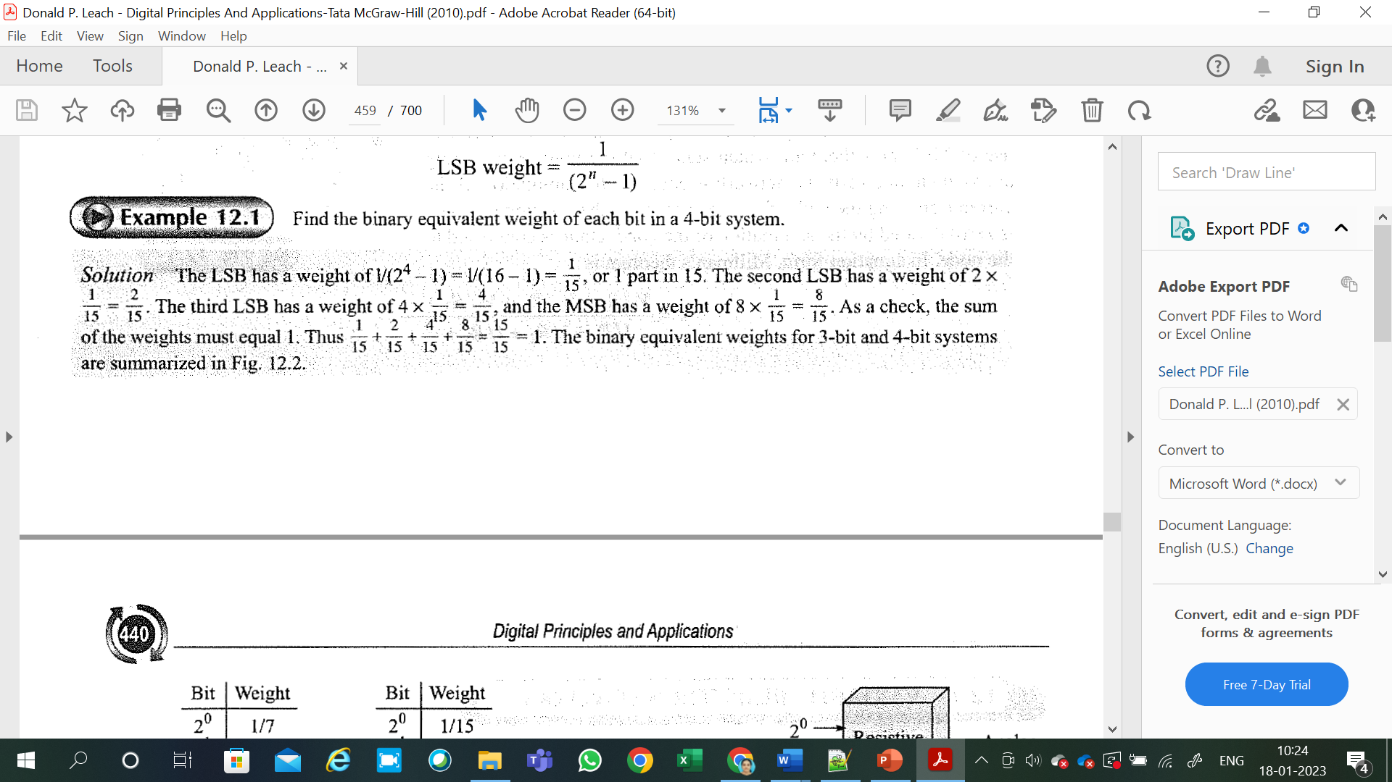
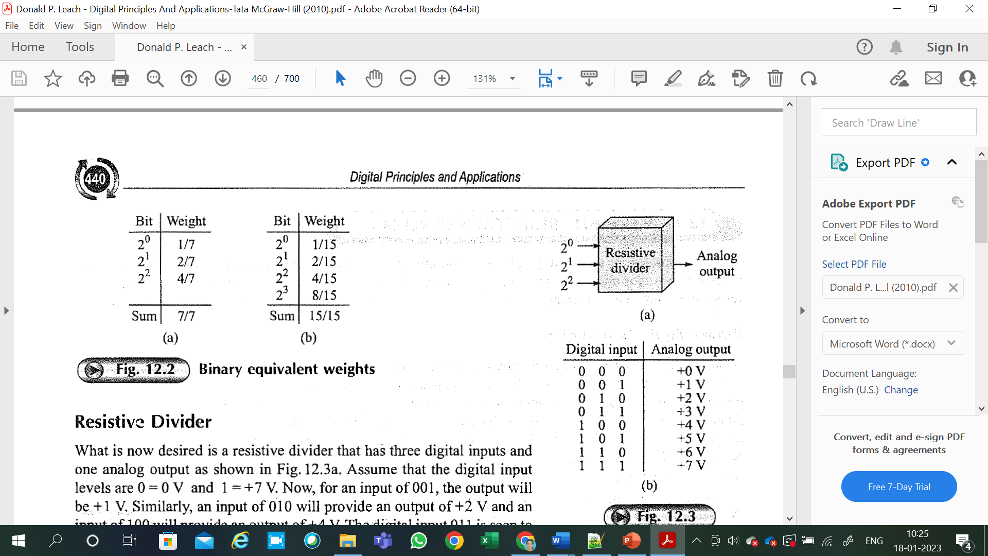

Slide 8
Resistive Divider

Slide 9
What is now desired is a resistive divider that has three digital inputs and one analog output as shown in Fig.12.3a.
Assume that the digital input levels are O = 0 V and 1 = +7 V.
Now, for an input of 001, the output will be + 1 V.
Similarly, an input of O 10 will provide an output of+ 2 V and an input of 100 will provide an output of +4 V.
The digital input O 11 is seen to be a combination of the signals 001 and 010.
If the+ 1 V from the 2° bit is added to the + 2 V from the 2¹ bit, the desired + 3 V output for the 011 input is achieved.
The other desired voltage levels are shown in Fig. 12.3b; they, too, are additive combinations of voltages.

Slide 10
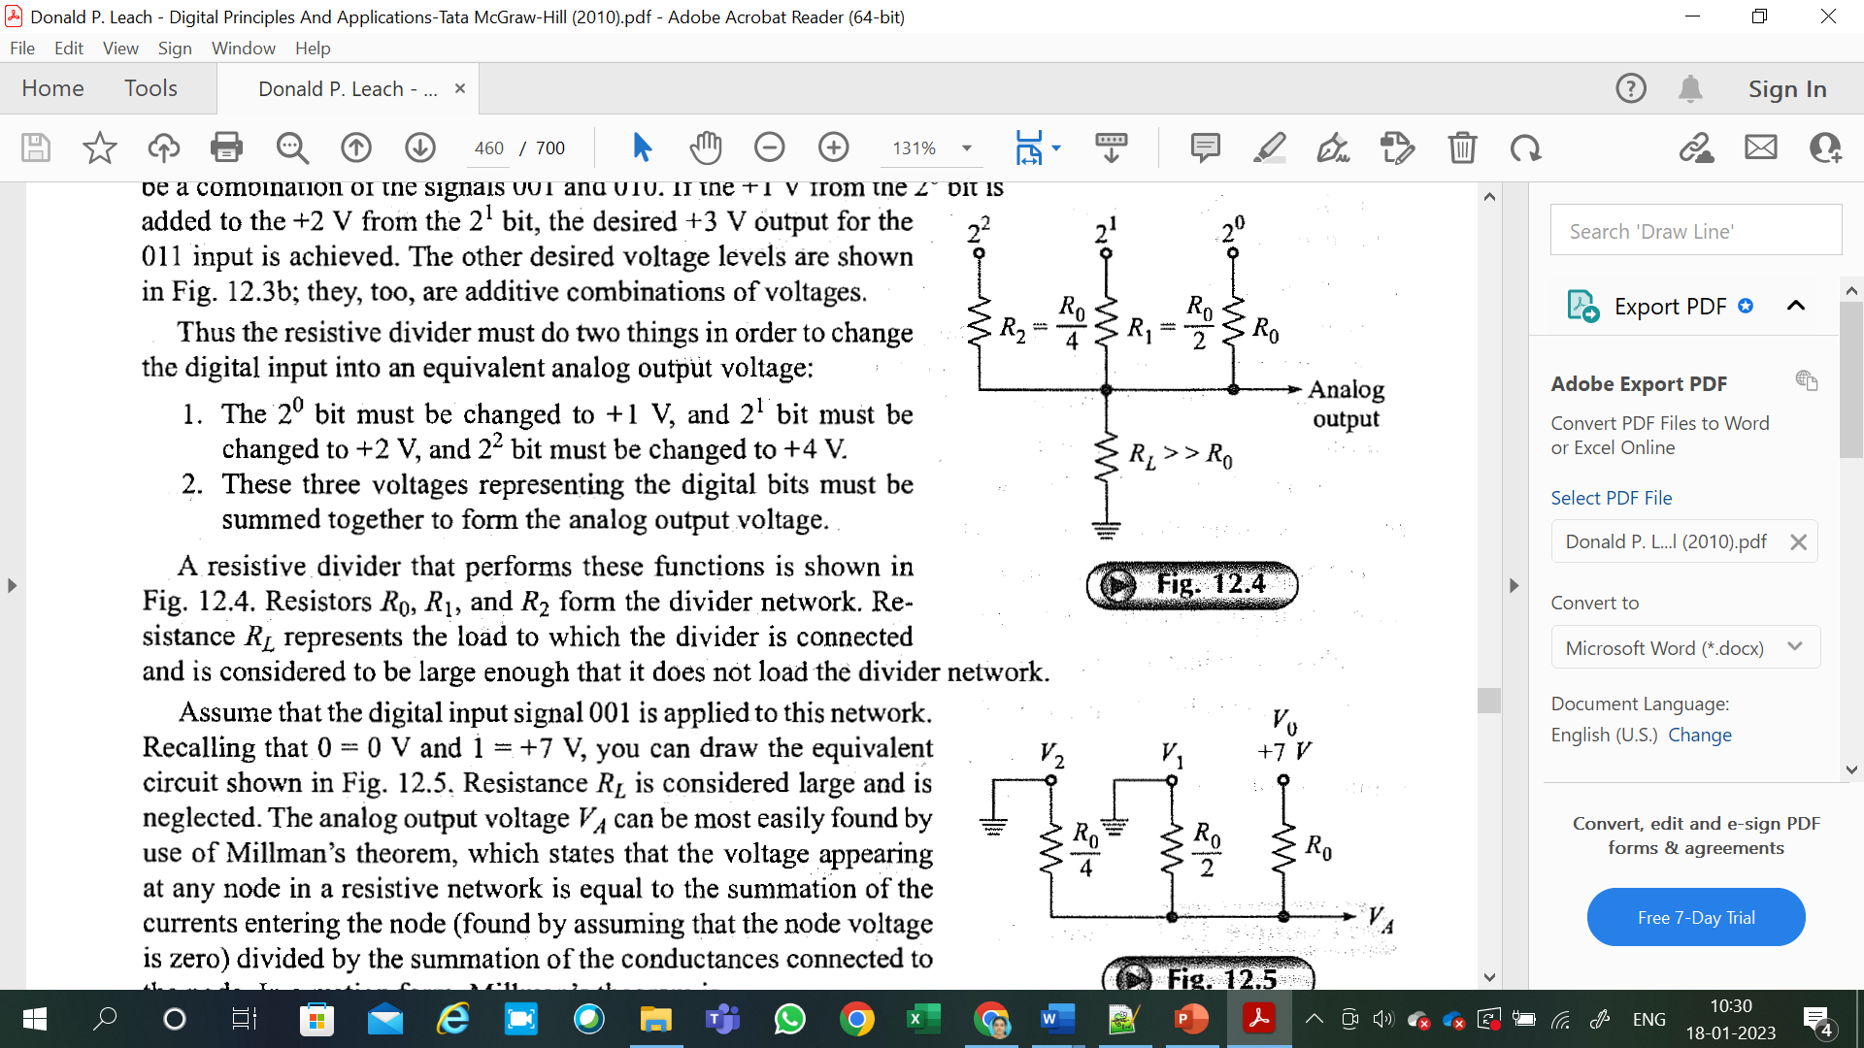

Slide 11
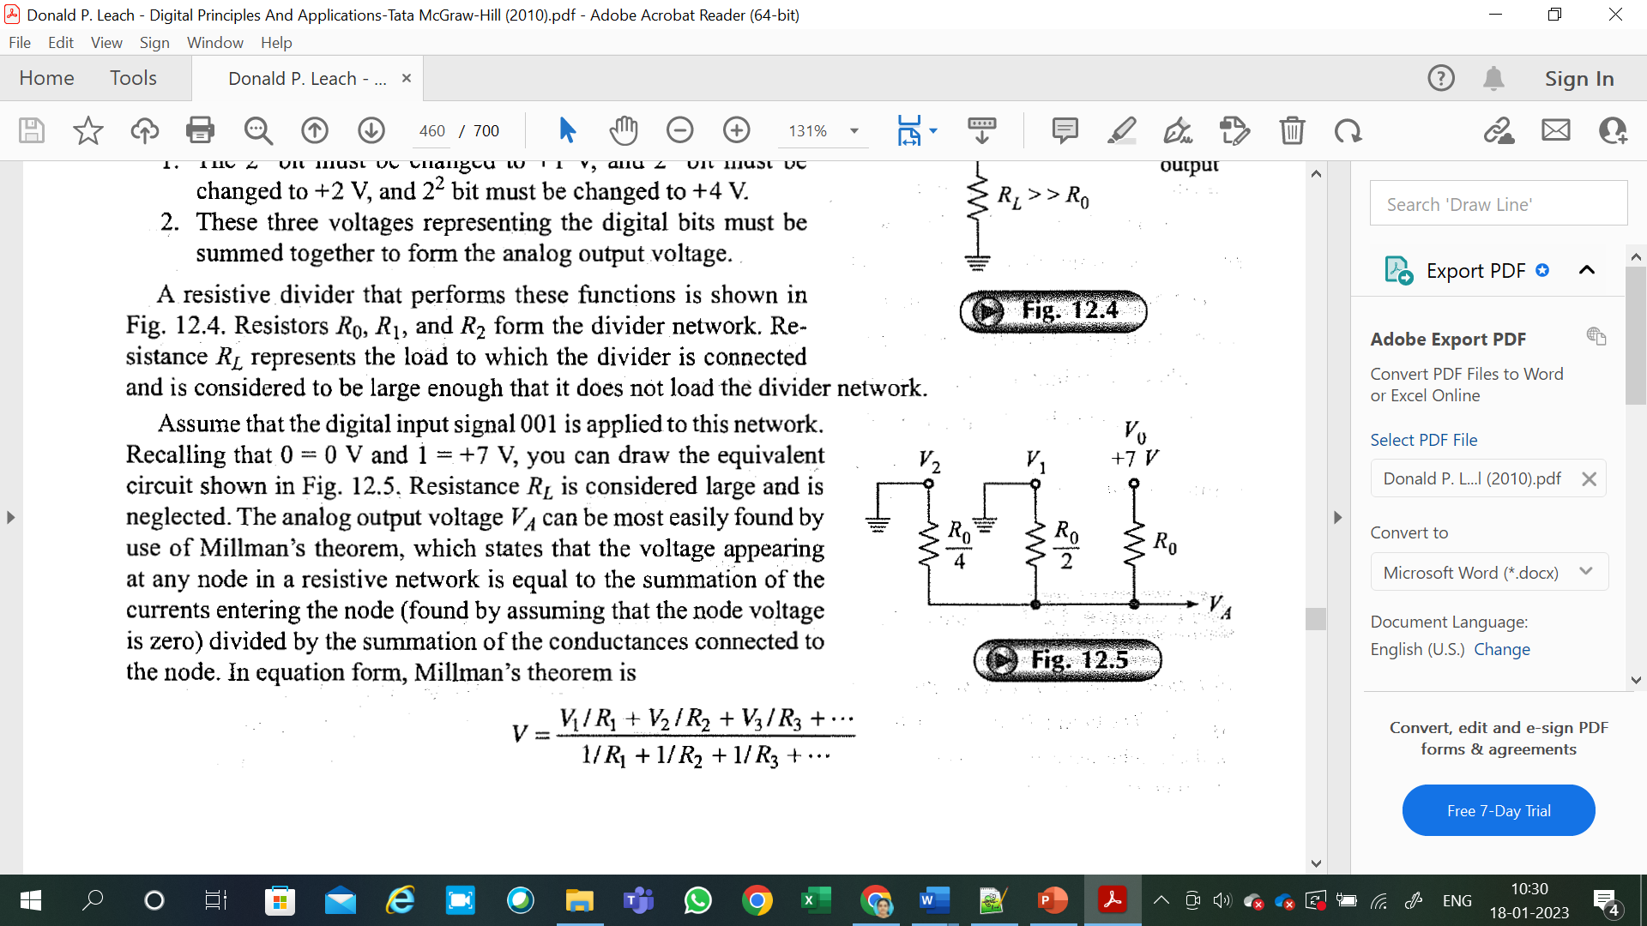

Slide 12
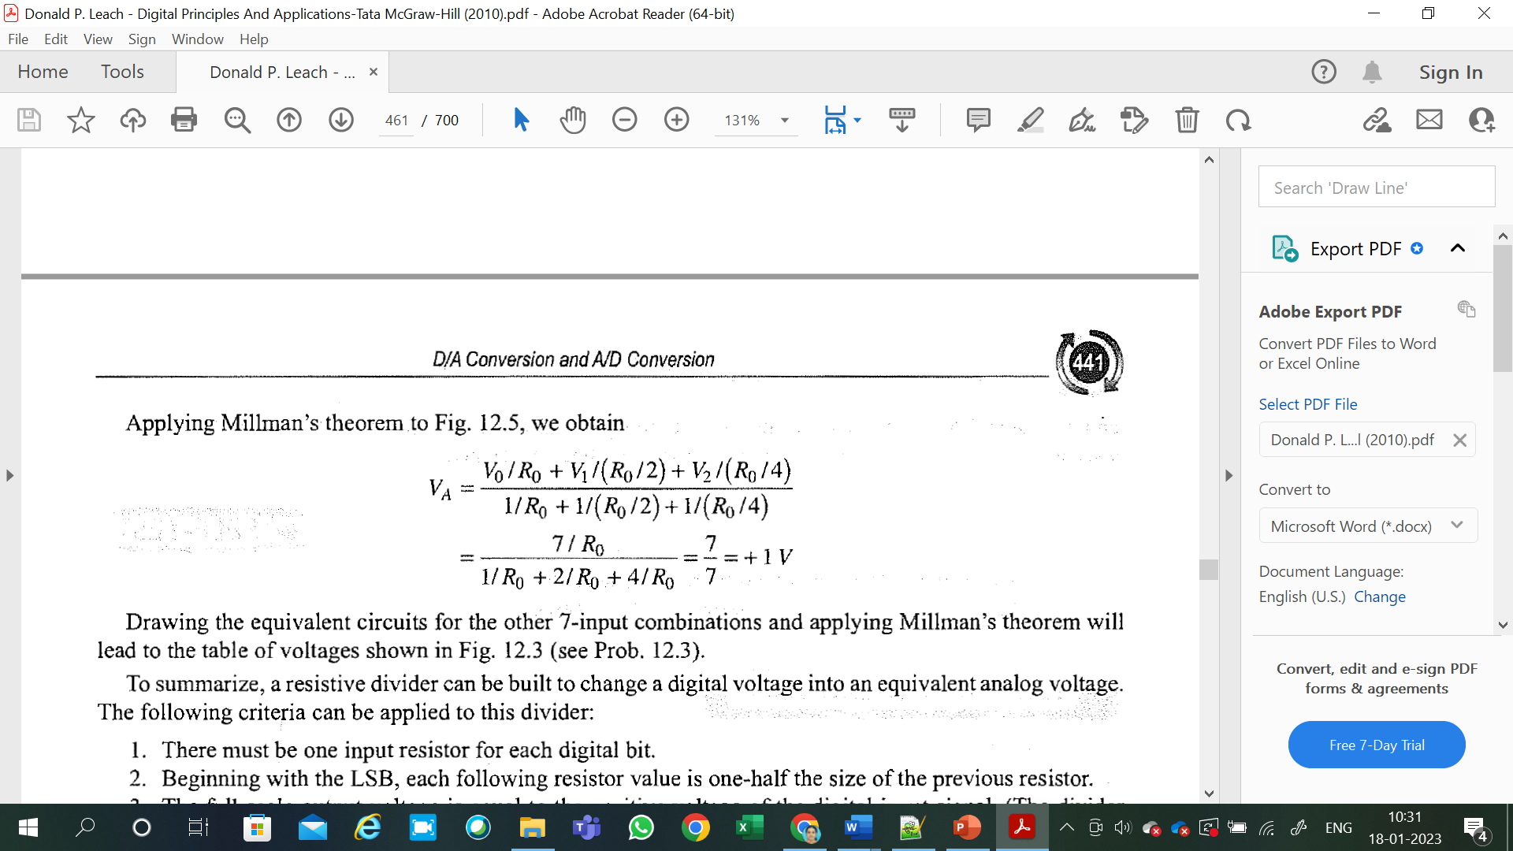

Slide 13
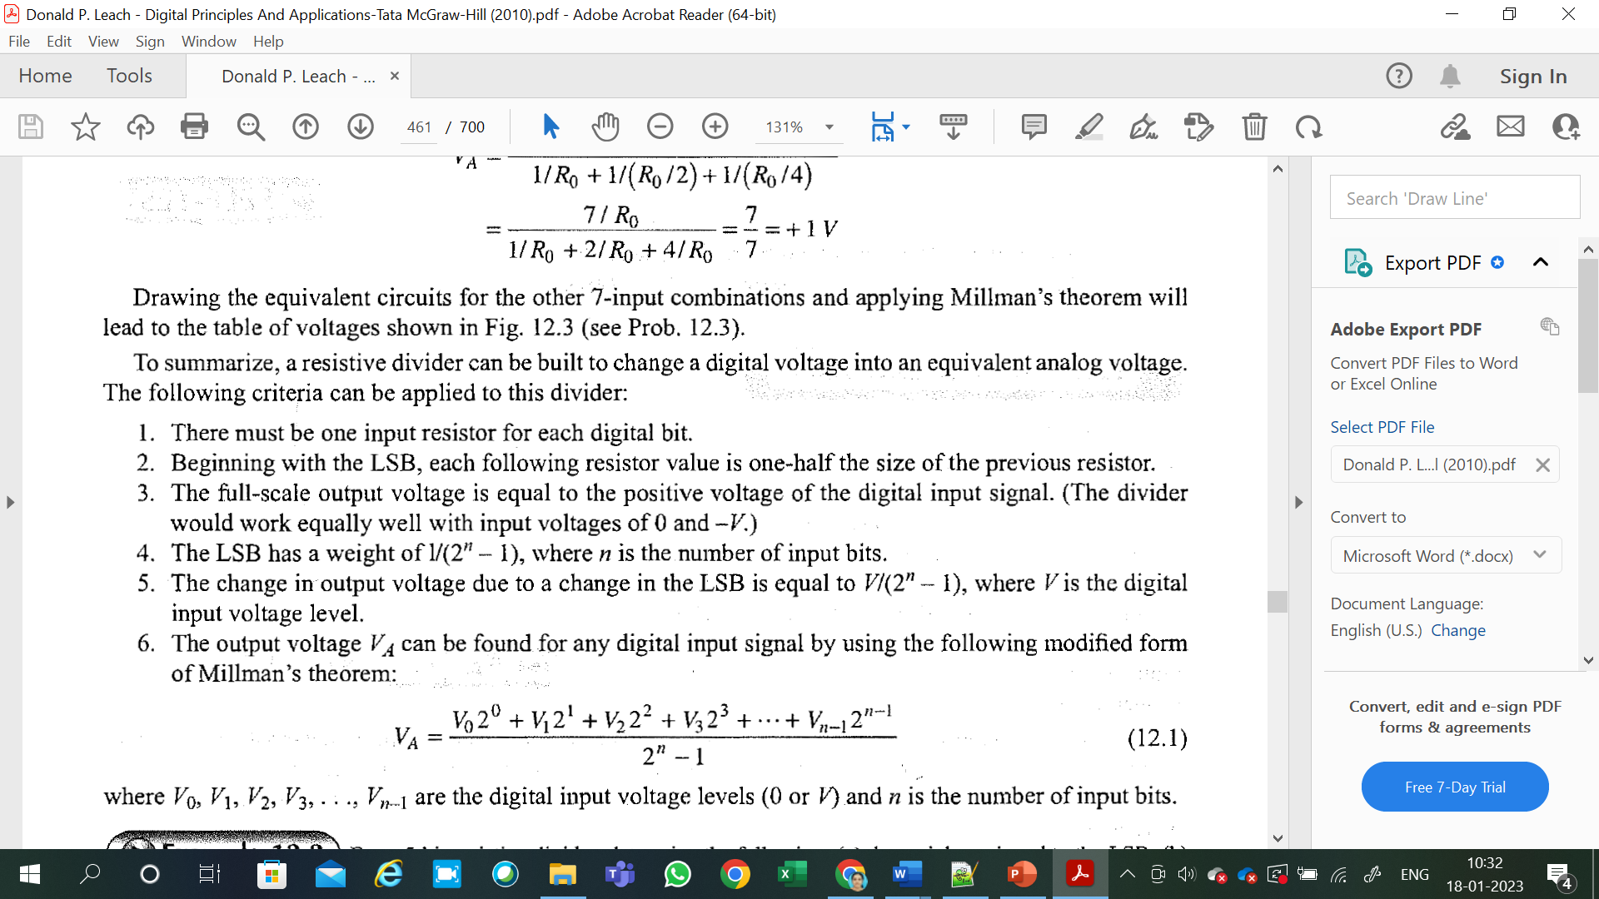

Slide 14
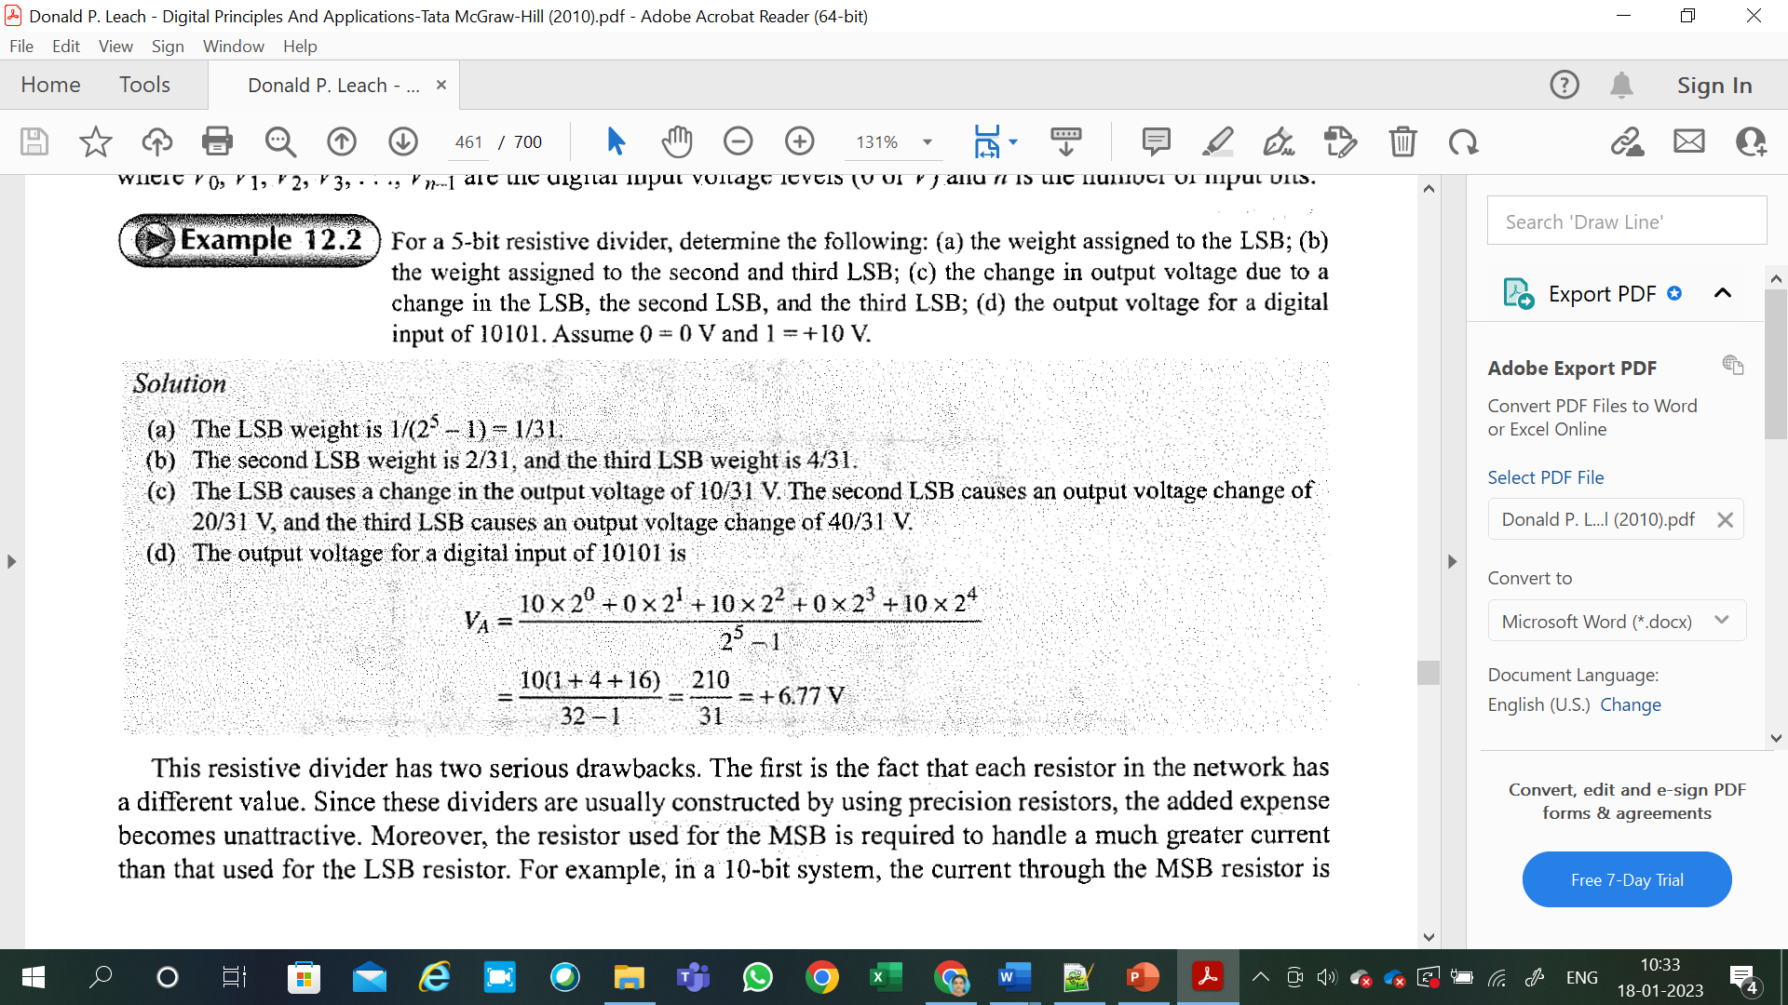

Slide 15
This resistive divider has two serious drawbacks.
The first is the fact that each resistor in the network has a different value.
Since these dividers are usually constructed by using precision resistors, the added expense becomes unattractive.
Moreover, the resistor used for the MSB is required to handle a much greater current than that used for the LSB resistor.

Slide 16
BINARY LADDERS
The binary ladder is a resistive network whose output voltage is a properly weighted sum of the digital inputs.
Such a ladder, designed for 4 bits, is shown in Fig. 12.6.
It is constructed of resistors that have only two values and thus overcomes one of the objections to the resistive divider previously discussed.
The left end of the ladder is terminated in a resistance of 2R, and we shall assume for the moment that the right end of the ladder (the output) is open-circuited.

Slide 17
Let us now examine the resistive properties of the network, assuming that all the digital inputs are at ground.
Beginning at node A, the total resistance looking into the terminating resistor is 2R.
The total resistance looking out toward the 2° input is also 2R.
These two resistors can be combined to form an equivalent resistor of value R as shown in Fig. 12.7.

Slide 18
Now, moving to node B, we see that the total resistance looking into the branch toward node A is 2R, as is the total resistance looking out toward the 2¹ input.
These resistors can be combined to simplify the network as shown in Fig.12.7.

Slide 19
From Fig. 12.7, it can be seen that the total resistance looking from node C down the branch toward nodeB or out the branch toward the 2² input is still 2R.
The circuit in Fig. 12.7 can then be reduced to the equivalentas shown in Fig. 12.7.
From this equivalent circuit, it is clear that the resistance looking back toward node C is 2R, as is the resistance looking out toward the 2³ input.

Slide 21
We can use the resistance characteristics of the ladder to determine the output voltages for the various digital inputs. First, assume that the digital input signal is 1000. With this input signal, the binary ladder can be drawn as shown in Fig. 12.8a. Since there are no voltage sources to the left of node D, the entire network to the left of this node can be replaced by a resistance of 2R to form the equivalent circuit shown in Fig. 12.8b. From this equivalent circuit, it can be easily seen that the output voltage is

Slide 22
To determine the output voltage due to the second MSB, assume a digital input signal of O 100. This can be represented by the circuit shown in Fig. 12.9a. Since there are no voltage sources to the left of node C, the entire network to the left of this node can be replaced by a resistance of 2R, as shown in Fig. 12.9b.

Slide 27
D/A CONVERTER
Either the resistive divider or the ladder can be used as the basis for a digital-to-analog (DIA) converter.
It is in the resistive network that the actual translation from a digital signal to an analog voltage takes place.
There is, however, the need for additional circuitry to complete the design of the DI A converter.
As an integral part of the DI A converter there must be a register that can be used to store the digital information.
The simplest register is formed by use of RS flip-flops, with one flip-flop per bit.
There must also be level amplifiers between the register and the resistive network to ensure that the digital signals presented to the network are all of the same level and are constant.
Finally, there must be some form of gating on the input of the register such that the flip-flops can be set with the proper infomation from the digital system.
A complete DI A converter in block-diagram form is shown in Fig. 12.13a.

Slide 28
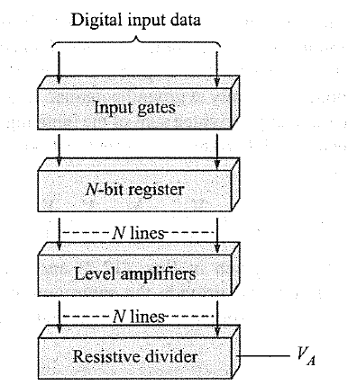

Slide 29
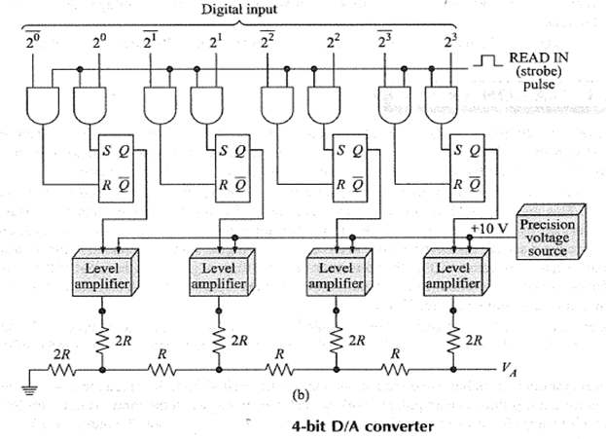

Slide 30
Let us expand on the block diagram shown in this Fig. 12.13a by drawing the complete schematic for a 4-bit DI A converter as shown in Fig. 12.13b.
You will recognize that the resistor network used is of the ladder type.
The level amplifiers each have two inputs: one input is the + 10 V from the precision voltage source, and the other is from a flip-flop. The amplifiers work in such a way that when the input from a flip-flop is high, the output of the amplifier is at +IO V. When the input from the flip-flop is. low, the output is O V.
The four flip-flops form the register necessary for storing the digital information.
The flip-flop on the right represents the MSB, and the flip-flop on the left represents the LSB.
Each flip-flop is a simple RS latch and requires a positive level at the R or S inpμt to reset or set it.
The gating scheme for entering information into the register is straightforward With this particular gating scheme, the flipflops need not be reset (or set) each time new information is entered.
When the READ IN line goes high, only one of the two gate outputs connected to each flip-flop is high, and the flip-flop is set or reset accordingly.
Thus data are entered into the register each time the READ IN (strobe) pulse occurs.
D flip-flops could be used in place of the RS flip-flops.

Slide 31
MULTIPLE SIGNALS
Quite often it is necessary to decode more than one signal-for example, the X and Y coordinates for a plotting board.
In this event, there are two ways in which to decode the signals.
The first and most obvious method is simply to use one DI A converter for each signal.
This method, shown in Fig. 12.14a, has the advantage that each signal to be decoded is held in its register and the analog output voltage is then held fixed.
The digital input lines are connected in parallel to each converter.
The proper converter is then selected for decoding by the select lines.
The second method involves the use of only one DI A converter and switching its output.
This is called multiplexing, and such a system is shown in Fig. 12.14b.
The disadvantage here is that the analog output signal must be held between sampling periods, and the outputs must therefore be equipped with sample-and hold amplifiers.

Slide 32
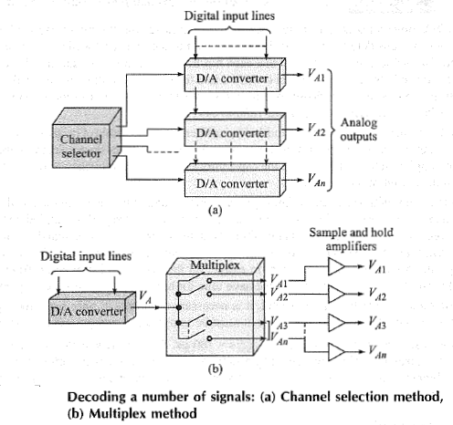

Slide 33
Sample and Hold Circuit
An OA connected as in Fig. 12.15a is a unity-gain noninverting voltage amplifier-that is, V0 = Vi- Two such OAs are used with a capacitor in Fig. 12.15b to form a sample-and-hold amplifier.
When the switch is closed, the capacitor charges to the DIA converter output voltage. When the switch is opened, the capacitor holds the voltage level until the next sampling time.
The operational amplifier provides a large input impedance s0 as not to discharge the capacitor appreciably and at the same time offers gain to drive external circuits.
When the DI A converter is used in conjunction with a multiplexer, the maximum rate at which the converter can operate must be considered.
Each time data is shifted into the register, transients appear at the output of the converter.
This is due mainly to the fact that each flip-flop has different rise and fall times.
Thus a settling time must be allowed between the time data is shifted into the register and the time the analog voltage is read out.
This settling time is the main factor in determining the maximum rate of multiplexing the output.
The worst case is when all bits change ( e.g., from 1000 to O 111 ).

Slide 34
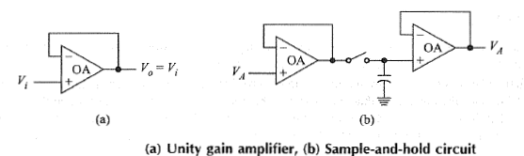
Naturally, the capacitors on the sample-and-hold amplifiers are not capable ofholding a voltage indefinitely;therefore, the sampling rate must be sufficient to ensure that these voltages do not decay appreciably between samples.
The sampling rate is a function of the capacitors as well as the frequency of the analog signal which is expected at the output of the converter.

Slide 35
The more often the signal is sampled, the less the sample degrades between samples. On the other hand, if too few samples are taken, the signal degrades too much (the sample-and-hold capacitors discharge too much), and the signal information is lost.
We would like to reduce the sampling rate to the minimum necessary to extract all the necessary information from the signal.
The solution to this problem involves more than we have time for here, but the results are easy enough to apply.
First, if the signal in question is sinusoidal, it is necessary to sample at only twice the signal frequency.
For instance if the signal is a 5-kHz sine wave, it must be sampled at a rate greater than or equal to 10 kHz.
In other words, a sample must be taken every 1000 s = 100 μs. What if the waveform is not sinusoidal?
Any waveform that is periodic can be represented by a summation of sine and cosine terms, with each succeeding term having a higher frequency.
In this case, it will be necessary to sample at a rate equal to twice the highest frequency of interest.

Slide 36
D/A CONVERTER TESTING
1. MONOTONICITY TEST
2. STEADY STATE TEST

Slide 37
Two simple but important tests that can be performed to check the proper operation of the DI A converter are the steady-state accuracy test and the monotonicity test.
The steady-state accuracy test involves setting a known digital number in the input register, measuring the analog output with an accurate meter, and comparing with the theoretical value.
Checking for monotonicity means checking that the output voltage increases regularly as the input digital signal increases.
This can be accomplished by using a counter as the digital input signal and observing the analog output on an oscilloscope.
For proper monotonicity, the output waveform should be a perfect staircase waveform, as shown in Fig. 12.16.
The steps on the staircase waveform must be equally spaced and of the . exact same amplitude.
Missing steps, steps of different amplitude, or steps in a downward fashion indicate malfunctions.

Slide 38
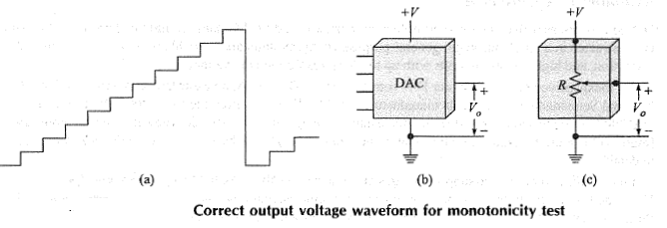

Slide 39
The monotonicity test does not check the system for accuracy, but if the system passes the test, it is relatively certain that the converter error is less than 1 LSB.
A DI A converter can be regarded as a logic block having numerous digital inputs and a single analog output as seen in Fig. 12.16b.
It is interesting to compare this logic block with the potentiometer shown in Fig. 12.16c.
The analog output voltage of the DI A converter is controlled by the digital input signals while the analog output voltage of the potentiometer is controlled by mechanical rotation of the potentiometer shaft.
Considered in this fashion, it is easy to see how a DI A converter could be used to generate a voltage waveform (sawtooth, triangular, sinusoidal, etc.).
It is, in effect, a digitally controlled voltage generator!

Slide 40
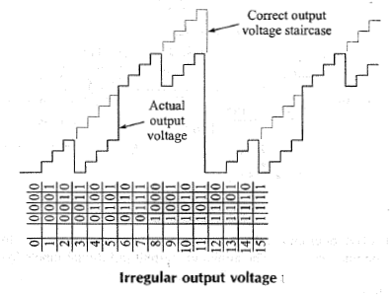
·At count 4 the output should be 4 units in amplitude. lnstead,it drops to 0
It remains 4 units below the correct level until it reaches count 8.
Then, from count 8 to 11, the output level is correct.
But again at count12 the output falls 4 units below the correct level and remains there for the next four. levels.
If you examine the waveform carefully, you will note that the output is 4 units below normal during the time when the 2² bit is supposed to be high.
This then suggests that the 2² bit is being dropped (i.e.,• the 2² input to the ladders not being held high) .
This means that the 2²-Ievel amplifier is malfunctioning or the AND gateis not operating properly.
In any case, the monotonicity check has clearly shown that the second MSB is not being used and that the converter is
not operating properly.

Slide 41
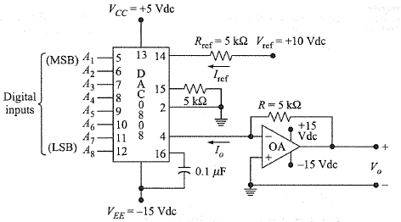
AVAILABLE D/A CONVERTER

Slide 42
Available D/A Converters
DI A converters, as well as sample-and-hold amplifiers, are readily obtainable commercial products.
Each unit is constructed in a single package; general-purpose economy units are available with 6-, 8-, 10-, and 12-bit resolution, and high-resolution units with up to 16-bit resolution are available.
An inexpensive and very popular DIA converter is the DAC0808, an 8-bit DIA converter available from National Semiconductor.
Motorola manufactures an 8-bit DIA converter, the MC1508/1408.
In Fig. 12.18, a DAC0808 is connected to provide a full-scale output voltage of V0 =+1O V dc when all 8 digital inputs are1s (high).
If the 8 digital inputs are all Os (low), the output voltage will be V0 = 0 Vdc.

Slide 43
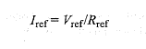
First of all, two de power-supply voltages are required for the DAC0808: V cc= +5 V de and VEE= -15 Vdc.
The 0.1-μF capacitor is to prevent unwanted circuit oscillations, and to isolate any variations in VEE·
Pin2 is ground (GND), and pin 15 is also referenced to ground through a resistor.
The output of the D/A converter on pin 4 has a very limited voltage range (+0.5 to -0.6 V).
Rather, it is designed to provide an output current of 10
• The minimum current (all digital inputs low) is 0.0 mA, and the maximum current (all digital inputs high), is Iref·
This reference current is established with the resistor at pin 14 and the reference voltage as

Slide 44
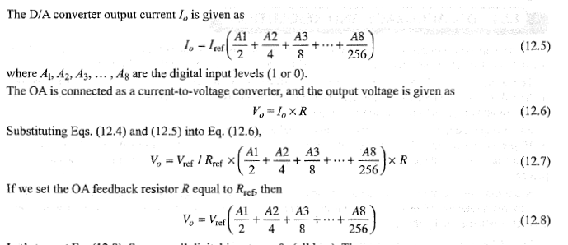

Slide 45
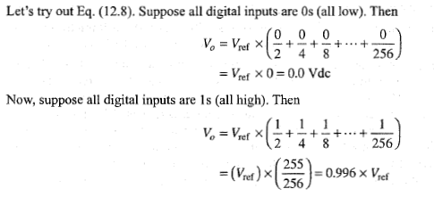

Slide 46
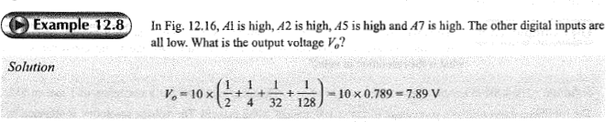

Slide 47
D/A ACCURACY AND RESOLUTION
The accuracy of the DIA converter is primarily a function of the accuracy of the precision resistors used in the ladder and the precision of the reference voltage supply used.
Accuracy is a measure of how close the actual output voltage is to the theoretical output value.
For example, suppose that the theoretical output voltage for a particular input should be+ 10 V.
An accuracy of l O percent means that the actual output voltage must be somewhere between +9 and + 11 V.
Similarly, if the actual output voltage were somewhere between +9.9 and+ 10.1 V, this would imply an accuracy of 1 percent.

Slide 48
Resolution, on the other hand, defines the smallest increment in voltage that can be discerned.
Resolution is primarily a function of the number of bits in the digital input signal; that is, the smallest increment in output voltage is determined by the LSB.
In a 4-bit system using a ladder, for example, the LSB has a weight of 1/16 . This means that the smallest increment in output voltage is 1/16 of the input voltage.
To make the arithmetic easy, let us assume that this 4-bit system has input voltage levels of + 16 V.
Since the LSB has a weight of 1/16 , a change in the LSB results in a change of 1 V- in the output.
Thus the output voltage changes in steps (or increments) of 1 V.
The output voltage of this converter is then the staircase shown in Fig. 12.16 and ranges from O to+ 15V in 1-V increments.
This converter can be used to represent analog voltages from O to + 15 V, but it cannot resolve voltages into increments smaller than 1 V.
If we desired to produce +4.2 V using this converter, therefore, the actual output voltage would be +4.0 V.

Slide 49
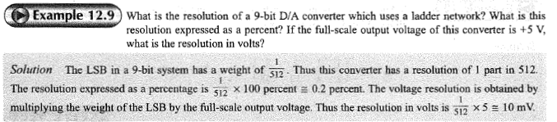

Slide 50
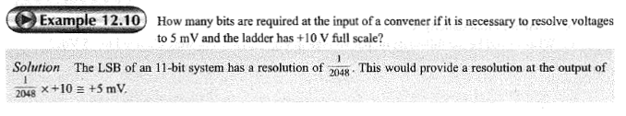

Slide 51
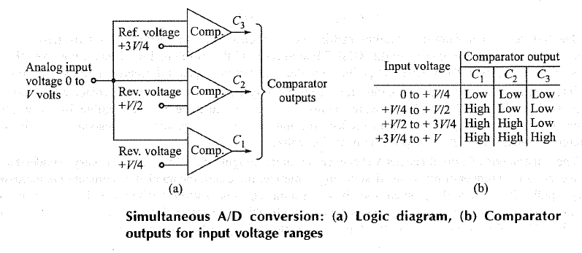
SIMULTANEOUS A/ D CONVERTER

Slide 52
The process of converting an analog voltage into an equivalent digital signal is known as analog-to-digital (A/D) conversion.
This operation is somewhat more complicated than the converse operation of DIA conversion.
A number of different methods have been developed, the simplest of which is probably the simultaneous method.
This is also known as A/D converter, flash type, the reason for which will be clear shortly.
The simultaneous method of A/D conversion is based on the use of a number of comparator circuits.
One such system using three comparator circuits is shown in Fig. 12.19 below.
The analog signal to be digitized serves as one of the inputs to each comparator. The second input is a standard reference voltage.
The reference voltages used are+ V/4, + V/2, and+ 3 V/4.
The system is then capable of accepting an analog input voltage between O and + V.

Slide 53
If the analog input signal exceeds the reference voltage to any comparator, that comparator turns on. (Let’s assume that this means that the output of the comparator goes high.)
Now, if all the comparators are off, the analog input signal must be between O and + V/4.
If C1 is high ( comparator C1 is on) and C2 and C3 are low, the input must be between+ V/4 and+ V/2 V.
If C1 and C2 are high while C3 is low, the input must be between + V/2 and+ 3 V/4.
Finally, if all comparator outputs are high, the input signal must be between+ 3 V/4 and+ V.
The comparator output levels for the various ranges of input voltages are summarized in Fig. 12.19.

Slide 54
Examination of Fig. 12.19 reveals that there are four voltage ranges that can be detected by this converter.
Four ranges can be effectively discerned by two binary digits (bits).
The three comparator outputs can then be fed into a coding network to provide 2 bits that are equivalent to the input analog voltage.
The bits of the coding network can then be entered into a flip-flop register for storage.
The complete block diagram for such an A/D converter is shown in Fig. 12.20.

Slide 55
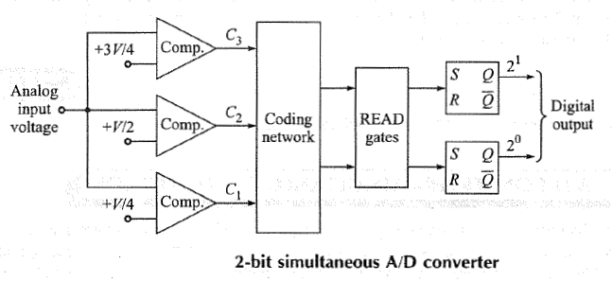

Slide 56
In order to gain a clear understanding of the operation of the simultaneous A/D converter, let us investigate the 3-bit converter shown in Fig. 12.21a.
Notice that in order to convert the input signal to a digital signal having 3 bits, it is necessary to have seven comparators (this allows a division of the input into eight ranges).
For the 2-bit converter, remember that three comparators were necessary for defining four ranges.
In general, it can be said that 2" - 1 comparators are required to convert to a digital signal that has n bits.
Some of the comparators have inverters at their outputs since both C and C complement are needed for the encoding matrix.

Slide 57
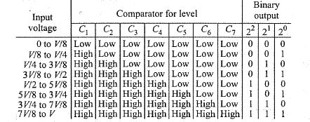

Slide 58
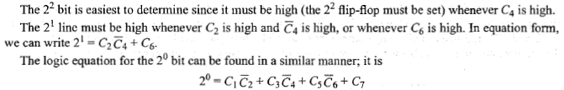

Slide 59
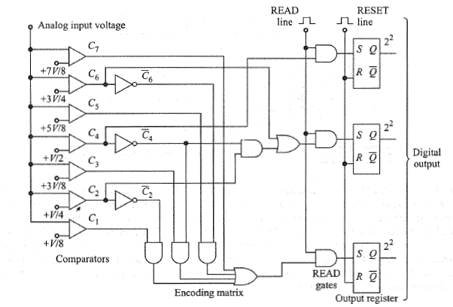

Slide 60
The transfer of data from the encoding matrix into the register must be carried out in two steps.
First, a positive reset pulse must appear on the RESET line to reset all the flip-flops low.
Then, a positive READ pulse allows the proper READ gates to go high and thus transfer the digital information into the flip-flops.
Interestingly, a convenient application for a 9318 priority encoder is to use it to replace all the digital logic as shown in Fig. 12.21b.
Of course, the inputs C1, C2, ... , C7 must be TTL-compatible.
In essence, the output of the 9318 is a digital number that reflects the highest-order zero input; this corresponds to the lowest reference voltage that still exceeds the input analog voltage.
The construction of a simultaneous A/D converter is quite straightforward and relatively easy to understand.
However, as the number of bits in the desired digital number increases, the number of comparators increases very rapidly (2" - 1 ), and the problem soon becomes unmanageable.
Even though this method is simple and is capable of extremely fast conversion rates, here are preferable methods for digitizing numbers having more than 3 or 4 bits.
Because it is so fast, this type of converter is frequently called a flash converter.

Slide 61
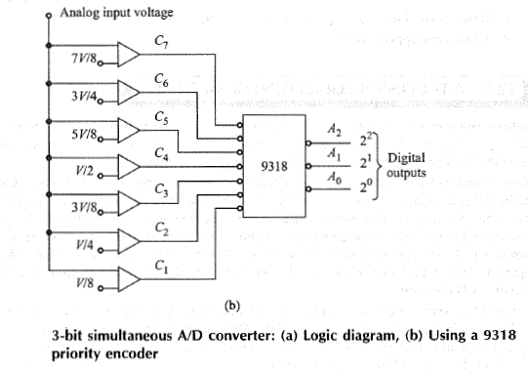

Slide 62
COUNTER TYPE A/D CONVERTER
A higher-resolution A/D converter using only one comparator could be constructed if a variable reference voltage were available.
This reference voltage could then be applied to the comparator, and when it became equal to the input analog voltage, the conversion would be complete.
To construct such a converter, let us begin with a simple binary counter.
The digital output signals will be taken from this counter, and thus we want it to be an n-bit counter, where n is the desired number of bits.
Now let us connect the output of this counter to a standard binary ladder to form a simple DI A converter.
If a clock is now applied to the input of the counter, the output of the binary ladder is the familiar staircase waveform shown in Fig. 12.16.
This waveform is exactly the reference voltage signal we would like to have for the comparator,With a minimum of gating and control circuitry, this simple DI A converter can be changed into the desired A/D converter.

Slide 63
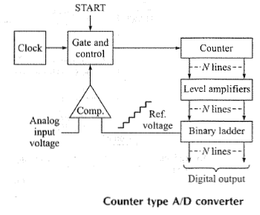
COUNTER TYPE A/D CONVERTER

Slide 64
Figure 12.23 shows the block diagram for a counter-type AID converter. The operation of the counter is as follows.
First, the counter is reset to all Os. Then, when a convert signal appears on the START line, the gate opens and clock pulses are allowed to pass through to the input of the counter.
The counter advances through its normal binary count sequence, and the staircase waveform is generated at the output of the ladder.
This waveform is applied to one side of the comparator, and the analog input voltage is applied to the other side.
When the reference voltage equals (or exceeds) the input analog voltage, the gate is closed, the counter stops, and the conversion is complete.
The number stored in the counter is now the digital equivalent of the analog input voltage.

Slide 65
Notice that this converter is composed of a DIA converter (the counter, level amplifiers, and the binary ladder), one comparator, a clock, and the gate and control circuitry.
This can really be considered as a closed-loop control system.
An error signal is generated at the output of the comparator by taking the difference between the analog input signal and the feedback signal (staircase reference voltage).
The error is detected by the control circuit, and the clock is allowed to advance the counter.
The counter advances in such a way as to reduce the error signal by increasing the feedback voltage.
When the error is reduced to zero, the feedback voltage is equal to the analog input signal, the control circuitry stops the clock from advancing the counter, and the system comes to rest.
The counter-type AID converter provides a very good method for digitizing to a high resolution.
This method is much simpler than the simultaneous method for high resolution, but the conversion time required is longer.
Since the counter always begins at zero and counts through its nom1al binary sequence, as many as 2n counts may be necessary before conversion is complete.
The average conversion time is, of course, 2"/2 or 2n-l counts.

Slide 66
The counter-type A/D converter provides a very good method for digitizing to a high resolution.
This method is much simpler than the simultaneous method for high resolution, but the conversion time required is longer.
Since the counter always begins at zero and counts through its normal binary sequence, as many as 2n counts may be necessary before conversion is complete.
The average conversion time is, of course, 2"/2 or 2n-l counts.
The counter advances one count for each cycle of the clock, and the clock therefore determines the conversion rate.
Suppose, for example, that we have a 10-bit converter. It requires 1024 clock cycles for a full-scale count.
If we are using a 1-MHz clock, the counter advances 1 count every microsecond.
Thus, to count full scale requires 1024 x 10⁻⁶ = 1.024 ms.
The converter reaches one-half full scale in half this time, or in 0.512 ms.
The time required to reach one-half full scale can be considered the average conversion time for a large number of conversions.

Slide 67
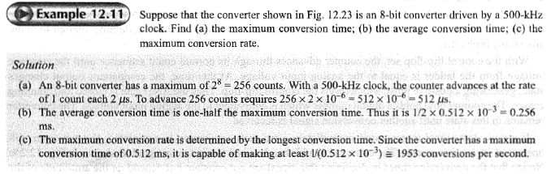

Slide 68
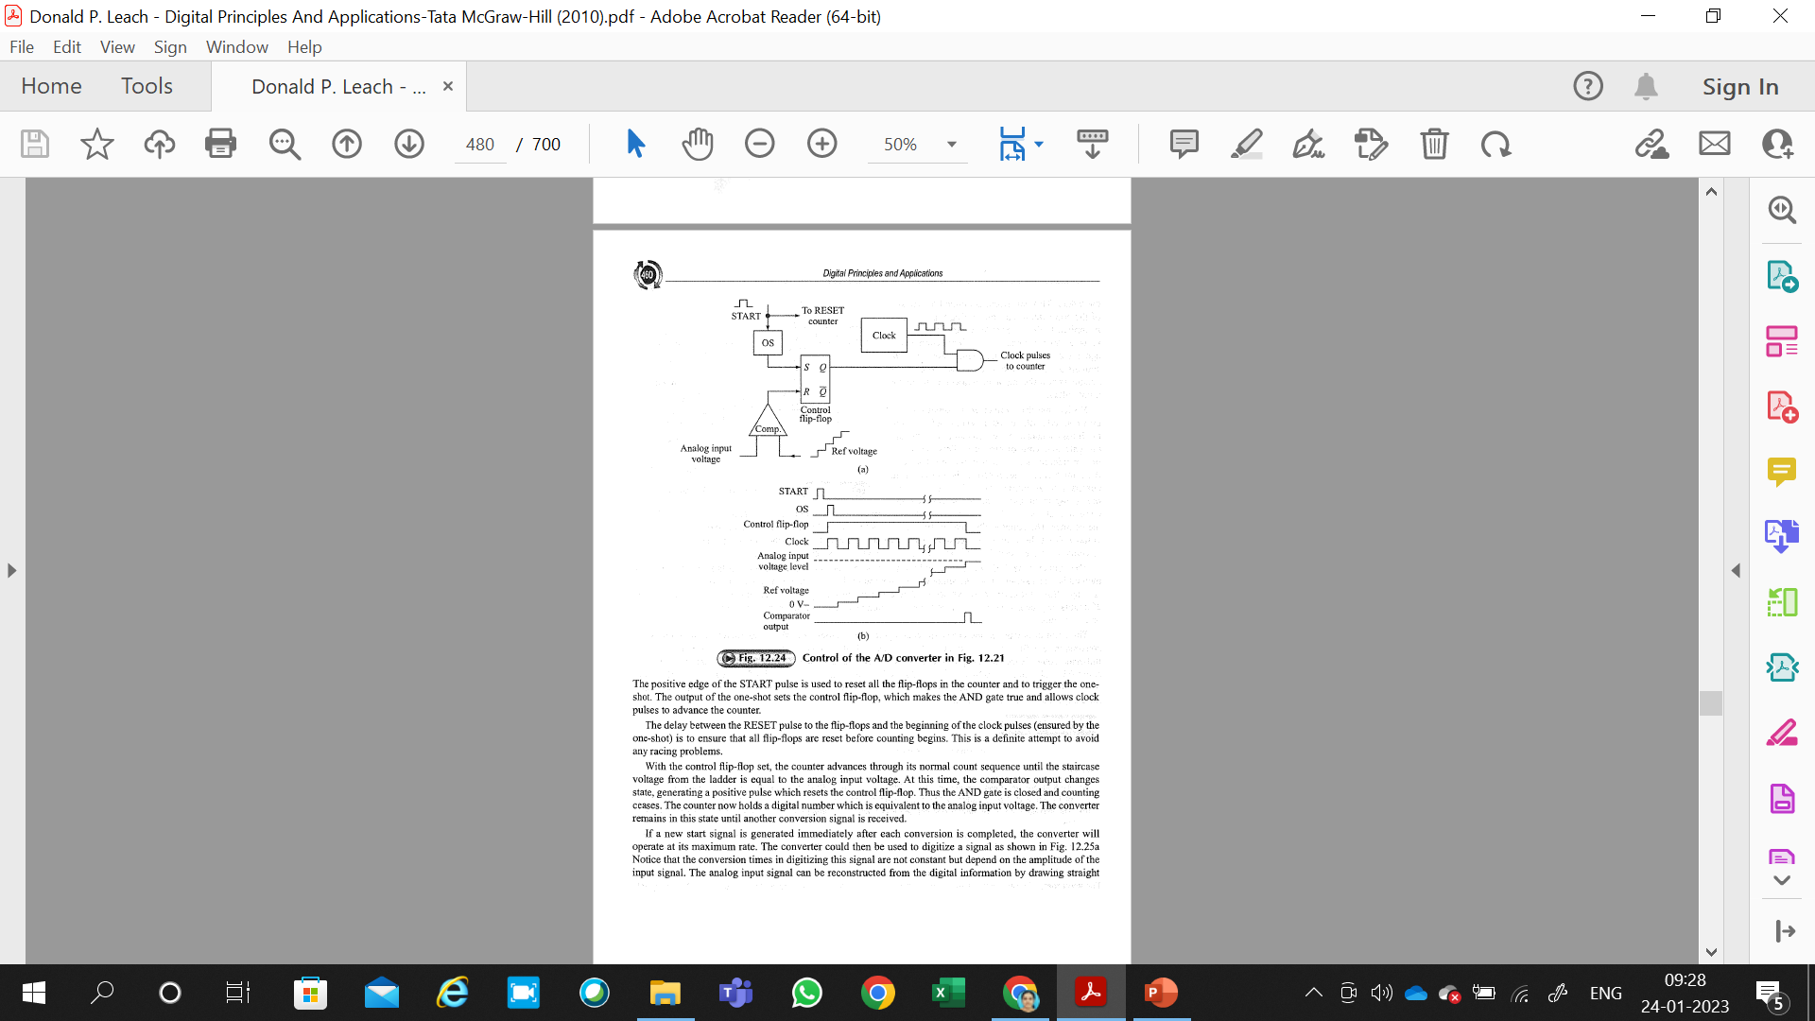
Figure -12.24 shows one method of implementing the control circuitry for the converter shown in Fig. 12.23.
The waveforms for one conversion are also shown.
A conversion is initiated by the receipt of a START signal.
The positive edge of the START pulse is used to reset all the flip-flops in the counter and to trigger the one shot.
The output of the one-shot sets the control flip-flop, which makes the AND gate true and allows clock
pulses to advance the counter.

Slide 69
The delay between the RESET pulse to the flip-flops and the beginning of the clock pulses ( ensured by the one-shot) is to ensure that all flip-flops are reset before counting begins.
This is a definite attempt to avoid any racing problems.
With the control flip-flop set, the counter advances through its normal count sequence until the staircase voltage from the ladder is equal to the analog input voltage.
At this time, the comparator output changes state, generating a positive pulse which resets the control flip-flop.
Thus the AND gate is closed and counting ceases.
The counter now holds a digital number which is equivalent to the analog input voltage.
The converter remains in this state until another conversion signal is received.

Slide 70
If a new start signal is generated immediately after each conversion is completed, the converter will
operate at its maximum rate.
The converter could then be used to digitize a signal as shown in Fig. 12.25a
Notice that the conversion times in digitizing this signal are not constant but depend on the amplitude of the input signal.
The analog input signal can be reconstructed from the digital information by drawing straight lines from each digitized point to the next.
Such a reconstruction is shown in Fig. 12.25b; it is, indeed, a reasonable representation of the original input signal.
In this case, it is important to note that the conversion times are smaller than the transient time of the input waveform.

Slide 71
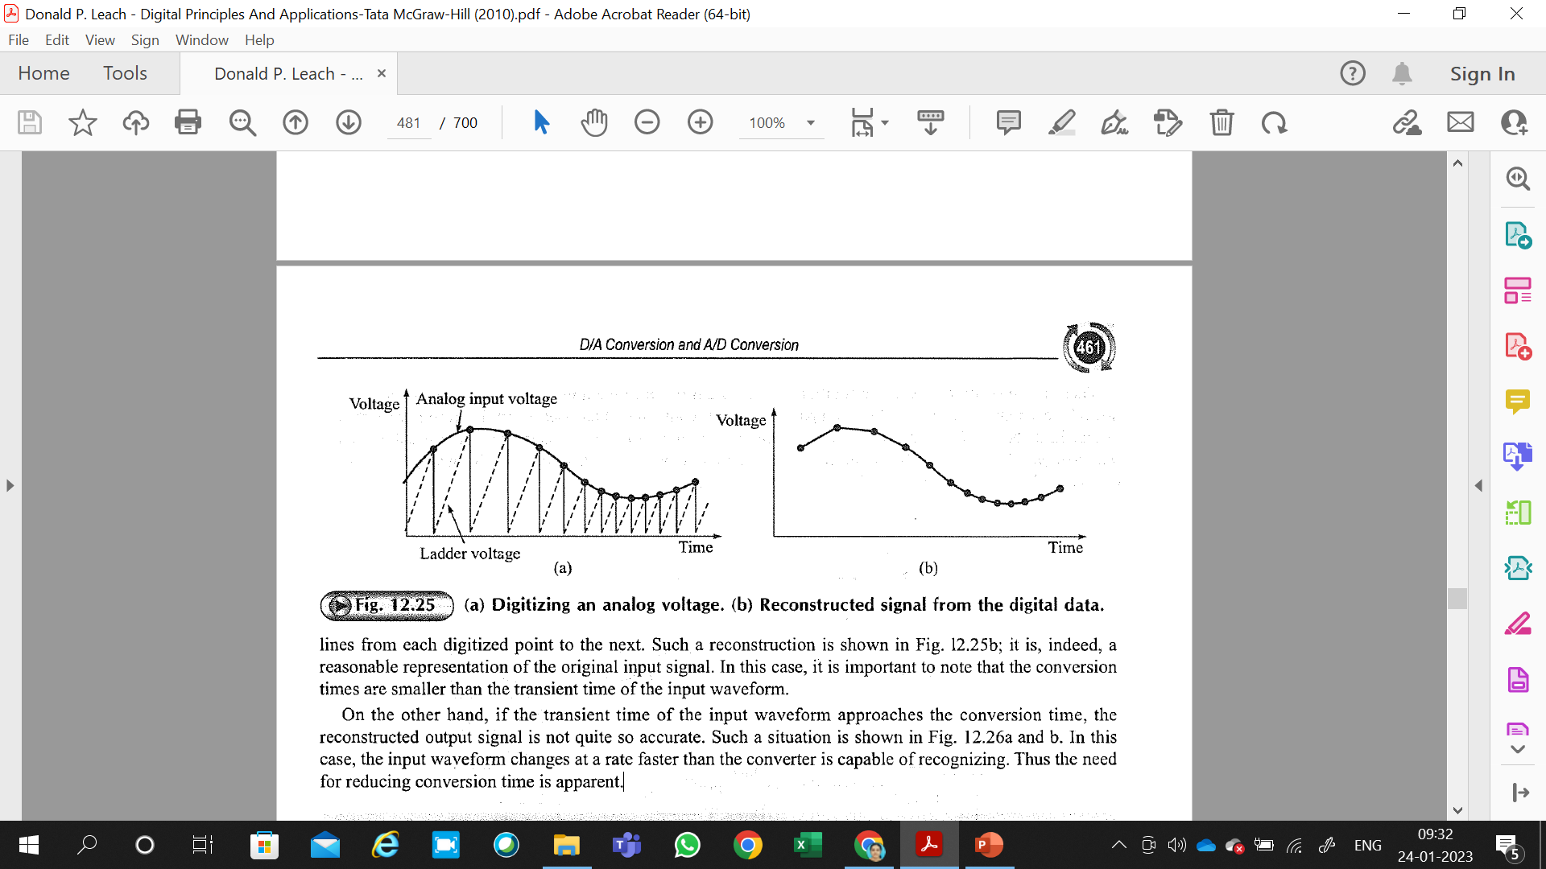
On the other hand, if the transient time of the input wavefonn approaches the conversion time, the reconstructed output signal is not quite so accurate.
Such a situation is shown in Fig. 12.26a and b.
In this case, the input waveform changes at a rate faster than the converter is capable of recognizing.
Thus the need for reducing conversion time is apparent.

Slide 72
CONTINUOUS A/D CONVERTER
An obvious method for speeding up the conversion of the signal as shown in Fig. 12.26 is to eliminate the need for resetting the counter each time a conversion is made.
If this were done. the counter would not begin at zero each time , but instead would begin at the value of the last converted point.
This means that the counter would have to be capable of counting either up or down.
This is no problem; we are already familiar with the operation of up-down counters.
There is, however, the need for additional logic circuitry, since we must decide whether to count up or down by examining the output of the comparator.
An AID converter which uses an up-down counter is shown in Fig. 12.27 below.
This method is known as continuous conversion, and thus the converter is called a continuous-type A/D converter.
Since the converter's digital output always tries to track the analog input to the converter, this is also known as A/D converter-tracking type.

Slide 73
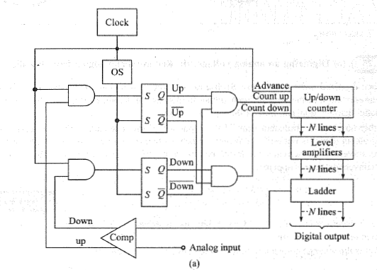

Slide 74
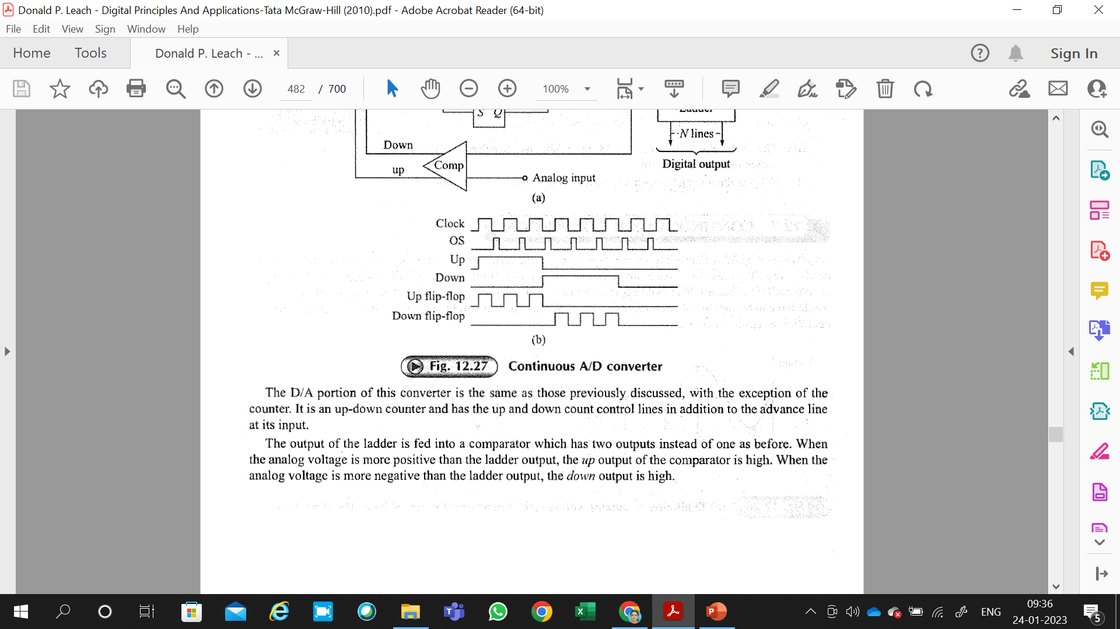
The D/ A portion of this converter. is the same as those previously discussed, with the exception of the counter.
It is an up-down counter and has the up and down count control lines in addition to the advance line at its input.
The output of the ladder is fed into a comparator which has two outputs instead of one as before.
When the analog voltage is more positive than the ladder output, the up output of the comparator is high.
When the analog voltage is more negative than the ladder output, the down output is high.

Slide 75
If the up output of the comparator is high, the AND gate at the input of the up flip-flop is open, and the first time the clock goes positive, the up flip-flop is set.
If we assume for the moment that the down flip-flop is reset, the AND gate which controls the count-up line of the counter will be true and the counter will advance one count.
The counter can advance only one count since the output of the one-shot resets both the up and the down flip-flops just after the clock goes low.
This can then be considered as one count-up conversion cycle.
Notice that the AND gate which controls the count-up line has inputs of up and down .
Similarly, the countdown line AND gate has inputs of down and up.
This could be considered an exclusive-OR arrangement and ensures that the count-down and count-up lines cannot both be high at the same time.

Slide 76
A/D TECHNIQUES
There are a variety of other methods for digitizing analog signals-too many to discuss in detail.
Nevertheless, we shall take the time to examine two more techniques and the reasons for their importance.
Probably the most important single reason for investigating other methods of conversion is to determine ways to reduce the conversion time.
Recall that the simultaneous converter has a very fast conversion time.
The counter converter is simple logically but has a relatively long conversion time.
The continuous converter has a very fast conversion time once it is locked on the signal but loses this advantage when multiplexing inputs.

Slide 77
Successive Approximation
If multiplexing is required, the successive-approximation converter is most useful.
The block diagram for this type of converter is shown in Fig. 12.30a.
The converter operates by successively dividing the voltage ranges in half.
The counter is first reset to all Os, and the MSB is then set.
The MSB is then left in or taken out (by resetting the MSB flip-flop) depending on the output of the comparator.
Then the second MSB is set in, and a comparison is made to determine whether to reset the second MSB flip-flop.
The process is repeated down to the LSB, and at this time the desired number is in the counter.
Since the conversion involves operating on one flip-flop at a time, beginning with the MSB, a ring counter may be used for flip-flop selection.

Slide 78
The successive approximation method thus is the process of approximating the analog voltage by trying 1 bit at a time beginning with the MSB.
The operation is shown in diagram form in Fig. 12.30b.
It can be seen from this diagram that each conversion takes the same time and requires one conversion cycle for each bit.
Thus the total conversion time is equal to the number of bits, n, times the time required for one conversion cycle.
One conversion cycle normally requires one cycle of the clock.
As an example, an 10-bit converter operating with a 1MHz clock has a conversion time of 10 x 10⁻⁶ = 10⁻⁵ = 10 μs.

Slide 79
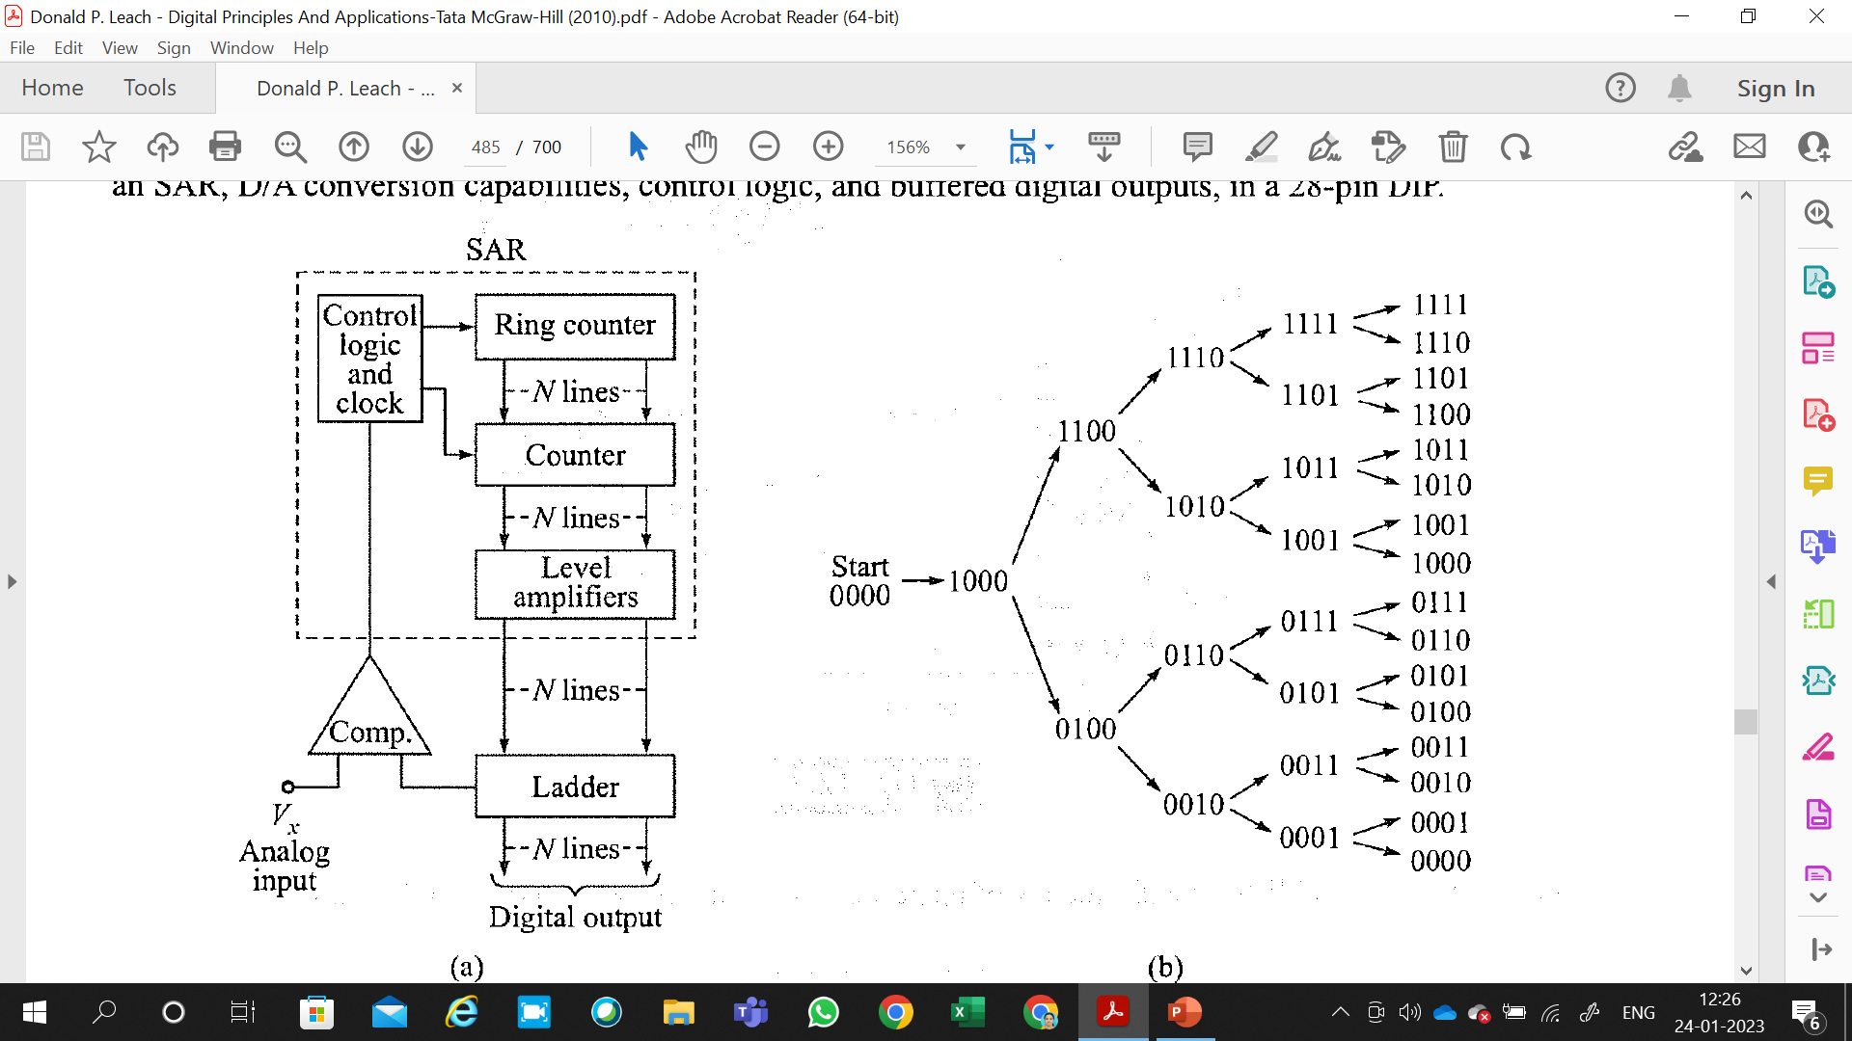

Slide 80
When dealing with conversion times this short, it is usually necessary to take into account the other delays in the system (e.g. switching time of the multiplexer, settling time of the ladder network, comparator delay, and settling time).
All the logic blocks inside the dashed line in Fig. 12.30a, or some equivalent arrangement, are frequently constructed on a single MSI chip; this chip is called a successive-approximation register (SAR).
For example, the Motorola MC6l08 shown in Fig. 12.28c is an 8-bit microprocessor-compatible AID converter that includes an SAR, DI A conversion capabilities, control logic, and buffered digital outputs, in a 28-pin DIP.

Slide 81
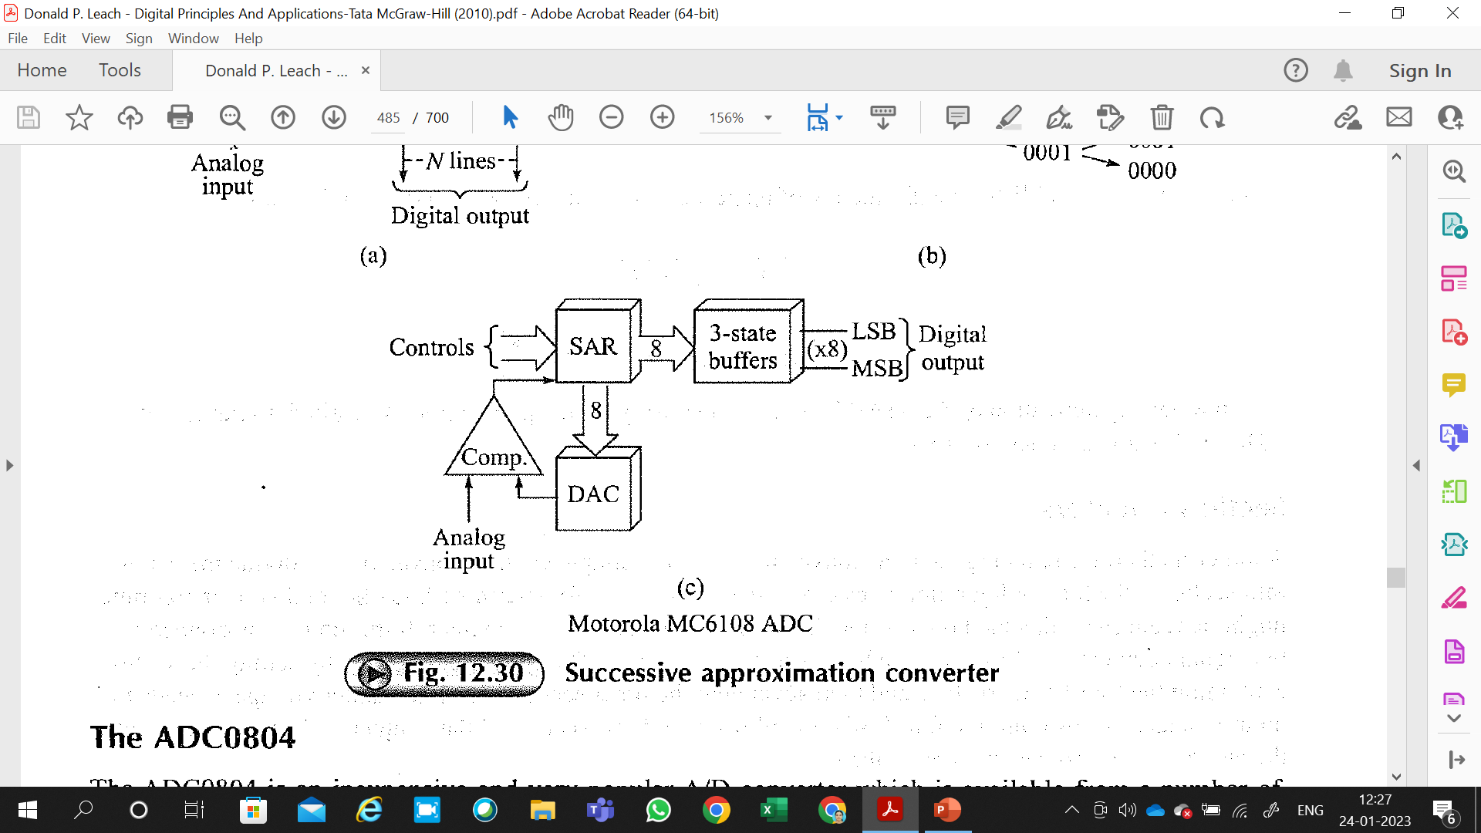

Slide 82
The ADC0804
The ADC0804 is an inexpensive and very popular AID converter which is available from a number of different manufacturers, including National Semiconductor.
The ADC0804 is an 8-bit CMOS microprocessor compatible successive-approximation AID converter that is supplied in a 20-pin DIP.
It is capable of digitizing an analog input voltage within the range O to + 5 V dc, and it only requires a single dc supply voltage-usually +5 Vdc.
The digital outputs are both TTL- and CMOS-compatible.
The block diagram of an ADC0804 is shown in Fig. 12.31.
In this case, the controls are wired such that the converter operates continuously. This is the so-called free-running mode.
The 10-k.Q resistor, along with the 150-pF capacitor, establishes the frequency of operation according to f=1/1.l(RC).

Slide 83
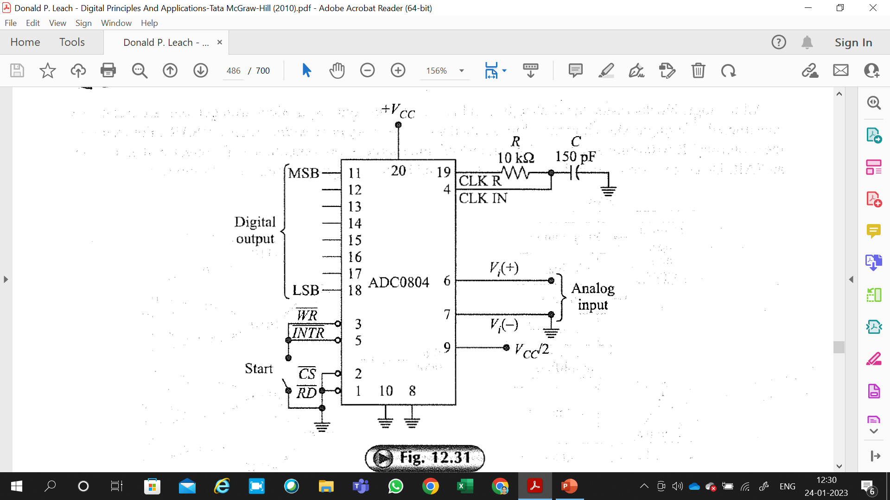
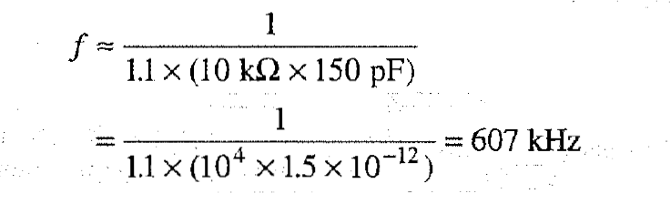

Slide 84
Section Counters
Another method for reducing the total conversion time of a simple counter converter is to divide the counter into sections.
Such a configuration is called a section counter.
To determine how the total conversion time might be reduced by this method, assume that we have a standard 8-bit counter.
If this counter is divided into two equal counters of 4 bits each, we haye a section converter.
The converter operates by setting the section containing the four LSBs to all Is and then advancing the other sections until the ladder voltage exceeds the input voltage.
At this point the four LSBs are all reset, and this section of the counter is then advanced until the ladder voltage equals the input voltage.

Slide 85
Notice that a maximum of 2⁴ = 16 counts is required for each section to count full scale.
Thus this method requires only 2 x 2⁴ = 2⁵ = 32 counts to reach full scale.
This is a considerable reduction over the 2⁸ = 256 counts required for the straight 8-bit counter.
There is, of course, some extra time required to set the counters initially and to switch from counter to counter during the conversion.
This logical operation time is very small, however, compared with the total time saved by this method.
This type of converter is quite often used for digital voltmeters, since it is very convenient to divide the counters by counts of 10.
Each counter is then used to represent one of the digits of the decimal number appearing at the output of the voltmeter.

Slide 86
A/D Accuracy and Resolution
Since the AID converter is a closed-loop system involving both analog and digital systems, the overall accuracy must include errors from both the analog and digital positions.
In determining the overall accuracy it is easiest to separate the two sources of error.
If we assume that all components are operating properly, the source of the digital error is simply determined by the resolution of the system.
In digitizing an analog voltage, we are trying to represent a continuous analog
voltage by an equivalent set of digital numbers.
When the digital levels are converted back into analog form by the ladder, the output is the familiar staircase waveform.
In trying to reproduce the analog input signal, the best we can do is to get on the step which most nearly equals the input voltage in amplitude.

Slide 87
The simple fact that the ladder voltage has steps in it leads to the digital error in the system.
The smallest digital step, or quantum, is due to the LSB and can be made smaller only by increasing the number of bits in the counter.
This inherent error is often called the quantization error and is commonly ± 1 bit.
If the comparator is centered, as with the continuous converter, the quantization error can be made ± 1/2 LSB.
The main source of analog error in the AID converter is probably the comparator.
Other sources of error are the resistors in the ladder, the reference-voltage supply ripple, and noise.
These can, however, usually be made secondary to the sources of error in the comparator.
The sources of error in the comparator are centered around variations in the dc switching point.
The dc switching point is the difference between the input voltage levels that cause the output to change state.
Variations in switching are due primarily to offset, gain, and linearity of the amplifier used in the comparator.
These parameters usually vary slightly with input voltage levels and quite often with temperature.
It is these changes which give rise to the analog error in the system.

Slide 88
In general, it is considered good practice to construct converters having analog and digital errors of approximately the same magnitudes.
There are many arguments for and against this, and any final argument would have to depend on the situation.
As an example, an 8-bit converter would have a quantization error of 1/256= 0.4 percent.
It would then seem reasonable to construct this converter to an accuracy of 0.5 percent in an effort to achieve an overall accuracy of 1.0 percent.
This might mean constructing the ladder to an accuracy of 0.1 percent, the comparator to an accuracy of 0.2 percent, and so on, since these errors are all accumulative.

Slide 89
